Slide 1
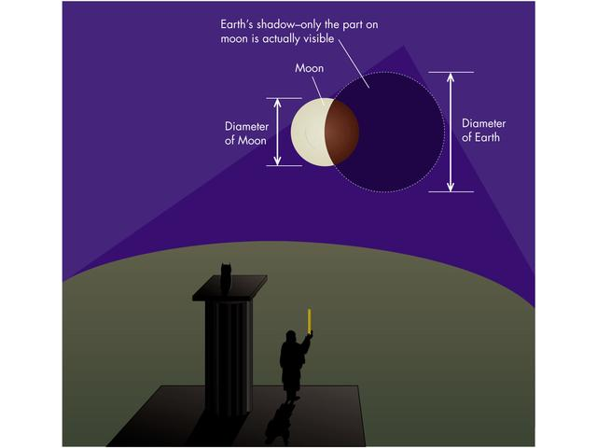
Rulers of the Universe: Aristarchus
Image Credit: Addison Wesley
Notes:
In the 3rd Century B.C. (about 75 years before Eratosthenes), a great Greek thinker figured out a way to measure the relative sizes and distances of the Moon and Sun. His name was Aristarchus of Samos (circa 310 - 230 BC).These calculations involve some straightforward logic and the application of simple geometry.
The first thing that Aristarchus noticed was that when the Moon was eclipsed by the Earth you could see the Earth's shadow creep across the face of the Moon. Earth's shadow is circular, and if you assume that the Sun's rays are roughly parallel to one another that implies that the size of Earth's shadow at the distance of the Moon is equal to the size of Earth. It's not exactly true, but it's very close. From the arc of Earth's shadow you can estimate the size of it's full circle, then you measure the size of the Moon's circle. This tells you the relative size of the Earth to the Moon.

Slide 2
Part 1: Relative Size of the Earth and Moon

Slide 3
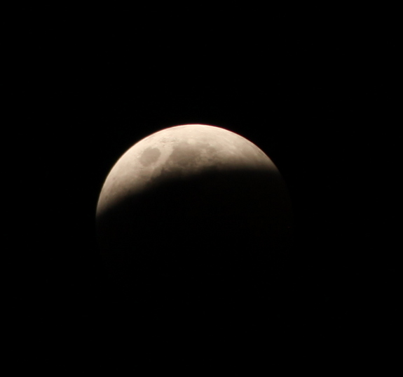
Notes:
Step 1: Photograph the Lunar Eclipse.
Use the Mr. Eclipse website to determine the timing in your location of the eclipse events (www.MrEclipse.com)
Use a digital camera mounted on a tripod.
For best results use a camera that allows you to manually control the exposure settings (ISO, f/number, shutter speed). The brightness of the Moon changes substantially during an eclipse. Mr. Eclipse has a handy guide for settings to use on your camera to best photograph the Moon at different stages of the eclipse (http://www.mreclipse.com/LEphoto/image/LE-Exposure1w.GIF). Be sure to turn off your flash and set your focus to infinity. You may also want to set your optical zoom to its maximum value.

Slide 4
Notes:
Step 2: Draw a circle to match the arc of Earth’s shadow on the Moon.
You can do this in PowerPoint, Photoshop, or several other photo editing or drawing programs. Insert a shape: circle
You can also simply print out the image and draw the circle by hand (perhaps use a compass to draw the best circle). You may want to print the inverse (negative) image so as not to use up all your black ink on your printer.
Step 3: Measure the size of the circle of Earth’s shadow and of the Moon.
If you did this digitally (i.e. with PowerPoint), you can simply read off the height/width of the circle in the Drawing Tools > Format menu. They should be equal unless you drew an ellipse and not a circle. This value is the diameter of the circle. The radius is half the diameter.
If you printed the image, you can use a ruler to measure the diameter of the Earth shadow circle and of the Moon.
Divide the values to determine the size of the Moon relative to the size of the Earth: R_{Moon}/R_{Earth} = ?, where R is the radius.
You should find R_{Moon}/R_{Earth} = 1.5”/3.9” (for this slide) = 0.385.
For the simplest learning experience, you could end the activity here. To go more in-depth you can continue.

Slide 5
Penumbra
Umbra
Penumbra
So not to scale!
Notes:
Looking down on the Earth-Moon-Sun system from above the Earth’s north pole:
This schematic drawing demonstrates why Earth’s shadow has an outer, not entirely dark, region, called the penumbra, and an inner dark shadow called the umbra. If the Sun were infinitely far away its rays would come in parallel to one another and Earth’s shadow would be a cylinder in space equal in width to the planet itself (blue lines).
Note #1: The umbra is not entirely empty of sunlight because Earth’s atmosphere refracts sunlight passing at the edges (limb) of the planet. Red light is bent more than blue light. So the Moon appears red when it is inside the umbra.
Note #2: If sun rays were coming in parallel (i.e. the Sun is infinitely far away) then the Sun would appear as an unresolved point in the sky; there would be no disk of the Sun.

Slide 6
Closer to scale: Moon is much farther away, however.
Notes:
The Sun appears to have a disk of about 0.5 degrees in width in the sky. This means that the true angle between the umbra and penumbra (as opposed to the grossly exaggerated one in the previous diagram) is 0.5 degrees.
By coincidence, the Moon is also 0.5 degrees in width in the sky. So the penumbra is one full Moon’s width in size.
The blue line, the theoretical cylinder-shaped shadow of Earth, bisects the penumbral shadow. This means that the true size of Earth compared to the Moon is 0.25 degrees larger than the umbral shadow.

Slide 7
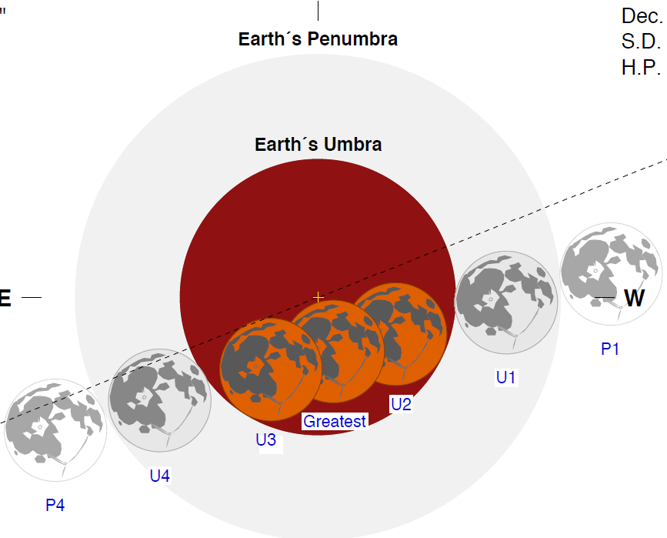
Earth’s Diameter
Notes:
Observing the lunar eclipse allows you to measure the size of the Moon relative to Earth.
The width of the penumbral ring is equal to the angular size of the Sun (0.5 degrees). Conveniently, the angular size of the Moon is also 0.5 degrees. So the penumbral ring is one full Moon’s width in size.
Earth’s diameter is about half that much (0.25 degrees) larger than the umbra. Use half the Moon’s width to figure out the true size of Earth compared to the Moon.
Image courtesy of NASA/F. Espenak

Slide 8
Radius_{Moon} = 0.273 x Radius_{Earth}
= 1.73 x 10³ km
Notes:
Step 4: Measure the true size of the Earth relative to the Moon.
The diameter of the Earth is half a Moon width larger than the umbral shadow.
Draw a circle on your eclipse photo that is one Moon radius larger than the umbral shadow’s radius (or one Moon diameter larger than the umbral diameter).
Measure the size of this circle and compare to the Moon: R_{Moon}/R_{Earth} = ?
You should find R_{Moon}/R_{Earth} = 1.5”/5.49” (for this slide) = 0.273.
So the Moon’s diameter/radius is about one-quarter the size of Earth’s.
You can calculate the value in kilometers knowing that Earth’s radius is 6,371 km

Slide 9
Part 2: Distance to the Moon

Slide 10
relate angular size with physical size to determine distance
R
d
θ
A
Angular size, A = 2 θ
Distance, d, relates to physical radius, R
d = R/Tan(θ)

Slide 11
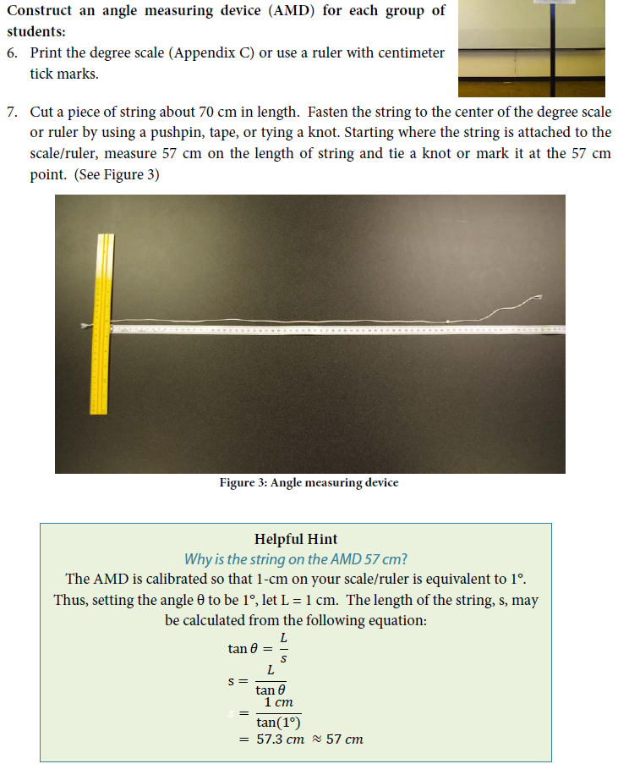
(Next page)
Camera Calibration:
Hold the AMD so that the numbers are facing the camera lens and the zero is in the center of the Moon. Making sure that the string is taut, hold the free end of the string just beneath the lens. Take a picture.
You will use this image to determine the calibration scale (number of pixels per degree). You only need to do this once if you use the same camera at the same zoom setting.

Slide 12
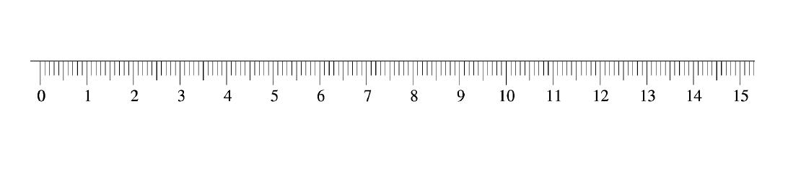

Slide 13
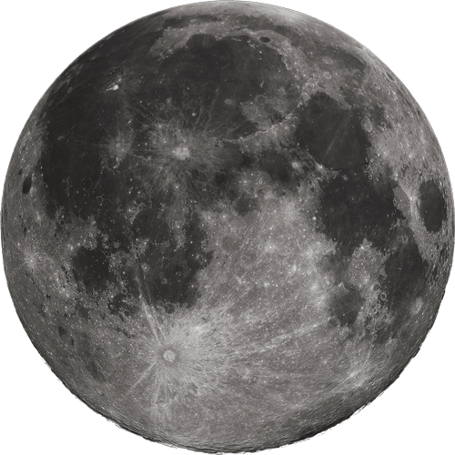
relate angular size with physical size to determine distance
Take a picture of the Moon and measure the width of the Moon in pixels. Use your calibration of number of degrees per pixel to calculate the angle.
R
d
θ
A
R_{Moon} = 0.273R_{Earth}

Slide 14
relate angular size with physical size to determine distance
Take a picture of the Moon and measure the width of the Moon in pixels. Use your calibration of number of degrees per pixel to calculate the angle.
R
d
θ
A
Angular size of Moon, A = 0.516 degrees
R_{Moon} = 0.273R_{Earth}
d = 0.273R_{Earth}/Tan(0.516 /2)
d = 60R_{Earth} = 3.84x10⁵ km

Slide 15
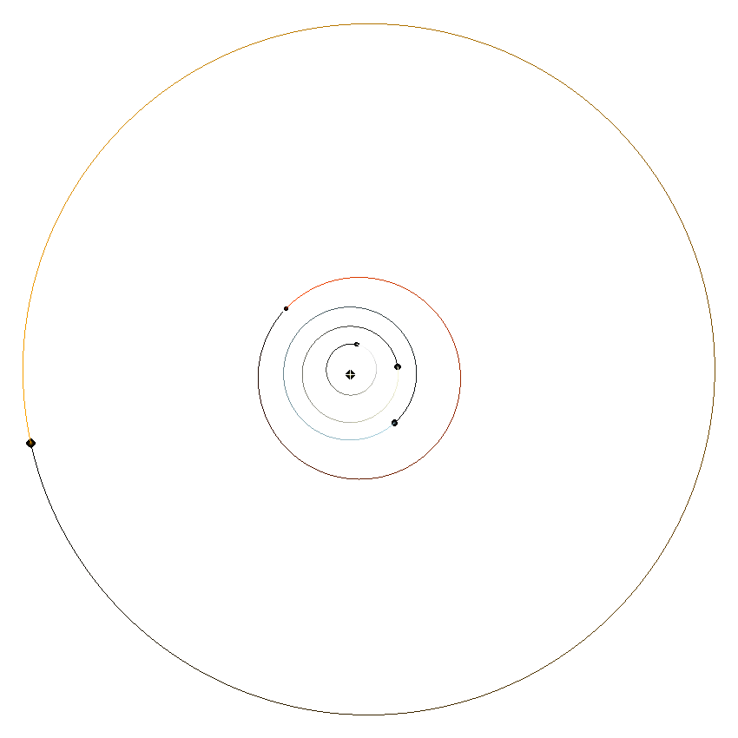
Part 3: Distance to the Sun
Mars
Mercury
Sun
Venus
Earth
Notes:
Aristarchus reasoned that when the Moon was seen to be exactly in either 1st or 3rd Quarter Phase (exactly half lit up as seen from Earth), we can draw a right triangle between Earth, Moon, and Sun.

Slide 16
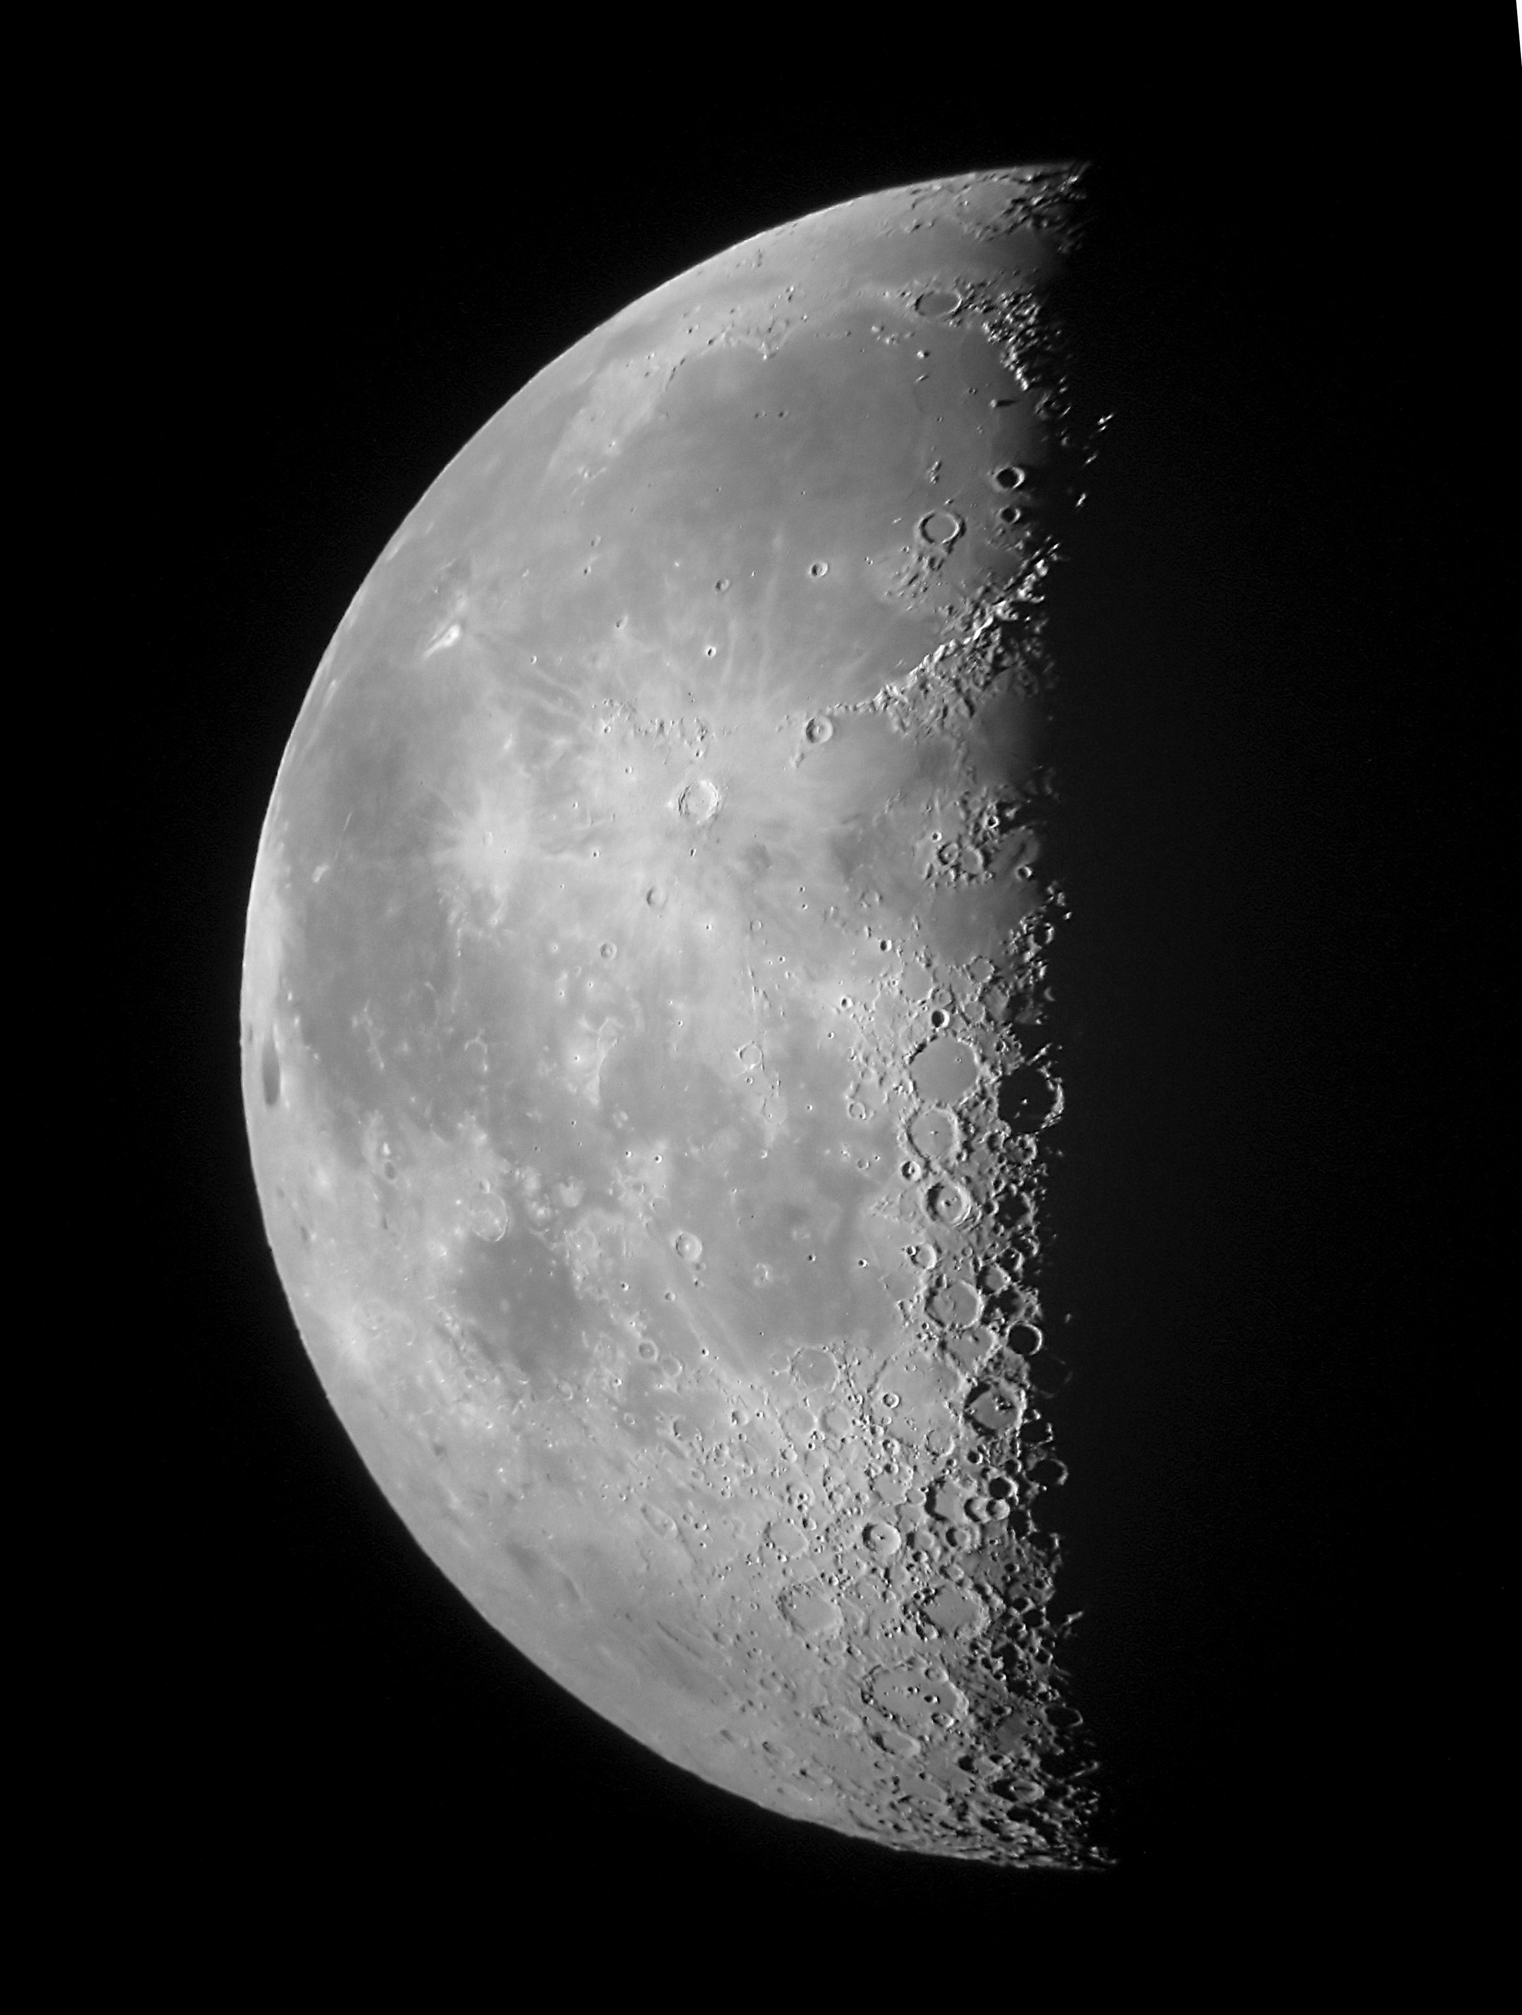

Slide 17
d_{Moon}
d_{Sun}
ɸ
Cos(ɸ) = d_{Moon}/d_{Sun}
d_{Sun} = d_{Moon}/Cos(ɸ)
Notes:
The legs of the right triangle are the distance from the Earth to the Moon (d_{Moon}) and the distance between the Moon and the Sun. The hypotenuse is then the distance between the Earth and Sun (d_{Sun}). We can measure the angle between d_{Moon} and d_{Sun}, it's the angular separation between the Sun and Moon in the sky. Once again a little simple trigonometry (cosine of the angle = adjacent/hypotenuse) then gives us the distance to the Sun.

Slide 18
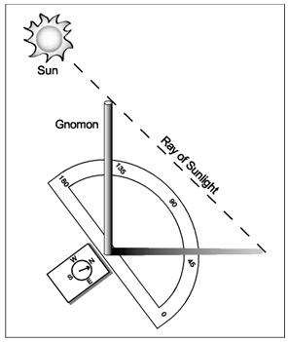
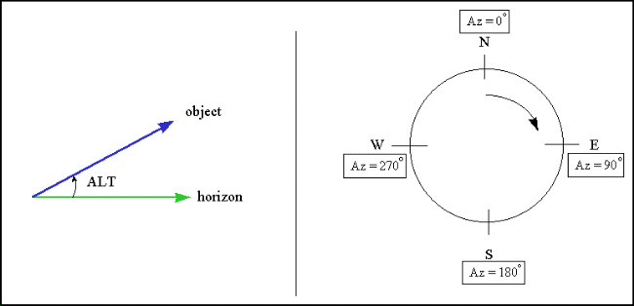
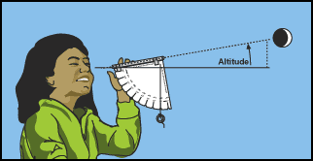
Use a gnomon to measure the cardinal directions, and the altitude and azimuth of the Sun.
Use a simple astrolabe to measure the altitude of the Moon. Use the gnomon to measure the azimuth.
Notes:
A gnomon (vertical stick) observed over the course of a day will help you determine the cardinal directions for your observing location. Measure its shadow over several hours around midday. The shadow will be shortest at local noon and will point directly north (in the northern hemisphere). You can then draw an Azimuth circle: 0/360 degrees = North, 90 degrees = East, 180 degrees = South, 270 degrees = West. The azimuth of the Sun will then be 180-degrees from where the shadow lies on the Azimuth circle (e.g. if the shadow falls on 270 then the Sun’s azimuth angle is 90).
When you observe the shadow of the gnomon cast by the Sun at any time, the Altitude of the Sun is the angle made between the shadow and the end of the shadow to the Sun. The tangent of the angle is equal to the length of the gnomon divided by the length of the shadow. So Alt = Arctan(gnomon/shadow).
To determine the alt and az of the Moon, you can use the azimuth circle and an astrolabe. See http://cse.ssl.berkeley.edu/AtHomeAstronomy/activity_07.html and http://cse.ssl.berkeley.edu/AtHomeAstronomy/activity_08.html for instructions on how to build and use one. All you need is a straw, some paper, and a metal washer.

Slide 19
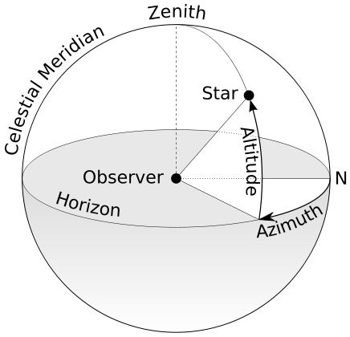
We’ll use spherical geometry and the altitude and azimuth measurements to determine the angle, ɸ, between the Sun and Moon.
Notes:
Use the Spherical Law of cosines to calculate the angle ɸ between the Sun and Moon:
ɸ = arccos[sin(az_{Sun})sin(az_{Moon}) + |alt_{Sun} – alt_{Moon}|cos(az_{Sun})cos(az_{Moon})]

Slide 20
d_{Moon}
d_{Sun}
ɸ
Cos(ɸ) = d_{Moon}/d_{Sun}
d_{Sun} = d_{Moon}/Cos(ɸ)
ɸ = 89.852 degrees
d_{Sun} = 389d_{Moon} = 1.496x10⁸ km
Notes:
This measurement is a difficult one to make because you need to determine when the Moon is exactly in quarter phase, which may happen while the Moon is below the horizon or the Moon could be up but the Sun might be beneath the horizon. A good way to estimate it would be to graph the angle as a function of time.
Make the measurements several times over the few days before and after the quarter phase. This would allow you to graph the angle with time. You can then draw a curve through the points. Also graph the phase (or percentage of illumination) as a function of time. Again, draw a best fit curve through the data. Use the curve to estimate the time that the Moon was 50% illuminated and then look to the graph of angle and determine what the angle was at that time.
The good news is that you get a chance to measure this angle twice per month.
This measurement was especially difficult for Aristarchus as trigonometry had not been invented yet.
He measured ɸ = 87°, and the real answer is ɸ = 89.852°

Slide 21
Part 4: Relative Size of the Earth and Sun

Slide 22

relate angular size with physical size to determine distance
Take a picture of the Sun and measure the width of the Sun in pixels. Use your calibration of number of degrees per pixel to calculate the angle.
R
d
θ
A
R = dTan(θ)
Notes:
To take a picture of the Sun, use a filter over your camera lens (neutral density or ).
If you can’t locate filter material. You could also try taking a picture of the Sun through clouds that are just thick enough to block a good deal of the sunlight but allow an image of the Sun to still make it through. Fog often presents an opportunity like this. You could also try snapping a picture at sunrise or sunset when the atmosphere has significantly dimmed the Sun.
If your camera allows for manual control of exposure parameters, the general rule to follow would be, zoomed in as far as possible, autofocus off and focus set to infinity, a shutter speed faster than 1/50 of a second, ISO setting less than 400, and an aperture of f/11 or higher. You may need to experiment with the settings depending on the time of day to get an image of the Sun’s disk and not a big saturated splotch.
This chart if for solar eclipses and assumes that you have a neutral density filter. If you do not have such a filter you may wish to increase the shutter speed from these recommendations: http://www.mreclipse.com/SEphoto/image/SE-Exposure1w.GIF

Slide 23
relate angular size with physical size to determine distance
Take a picture of the Sun and measure the width of the Sun in pixels. Use your calibration of number of degrees per pixel to calculate the angle.
R
d
θ
A
R = dTan(θ)
Angular size of Sun, A = 0.533 degrees
R_{Sun} = d_{Sun}Tan(0.533/2) = 1.81d_{Moon} = 109 R_{Earth}

Slide 24
Part 5: Discussion
R_{Moon} = 0.273R_{Earth}
d_{Moon} = 60R_{Earth}
d_{Sun} = 389d_{Moon}
R_{Sun} = 109 R_{Earth} = 399 R_{Moon}
Notes:
Aristarchus was able to establish that the Sun was bigger than Earth. Since this was so, he reasoned that it would make more sense for Earth to orbit the Sun rather than the other way around.
But his contemporaries pointed to an argument that contradicted such an idea. The stars should exhibit parallax if Earth goes about the Sun.
Aristarchus supposed that the stars were so far away that we could not measure their very small parallax. He thought at such great distances the Sun might appear as a star and wondered if the stars were in fact other suns with other worlds circling them.
This was 2,300 years ago! He was absolutely right. But it would take some 2,000 years for his ideas to be vindicated.

